Slide 2
Overview
Course Overview
Day 1:
Introduction to Mplus; how to get your data into Mplus; regression analysis in SPSS and Mplus; diagrammer
Day 2:
How to conduct CFA/EFA in Mplus; discussion of measurement invariance and its recent advances;
Day 3:
Factor analysis; Path analysis; Mediation; Full SEM;
Day 4
Longitudinal mediation analyses using a cross-lagged panel design; accounting for stable between-person differences with the random-intercept cross-lagged panel model (RI-CLPM).
Day 5
Consultations

Slide 3
Overview
Schedule
8.45 coffee
9.00 start lecture => Ruppert Wit
11.00 coffee
12.15 lunch (included) => Educatorium
13:15 start computer lab => Ruppert 038
15.30 soft drinks
16.30 end

Slide 4

Your new best friends
Notes:
* You get a few new friends today ☺

Slide 5
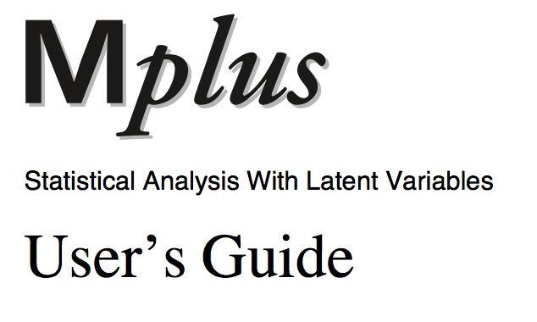
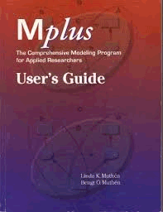
Friend 1
Find it on www.statmodel.com
Notes:
* Examples in it; shows input file; practice with the examples; they saved the data file and input file; you can experiment with it * all options are in the users guide (latent class, multilevel) * it gives you a nice basic set up – you don’t have to start from scratch

Slide 6
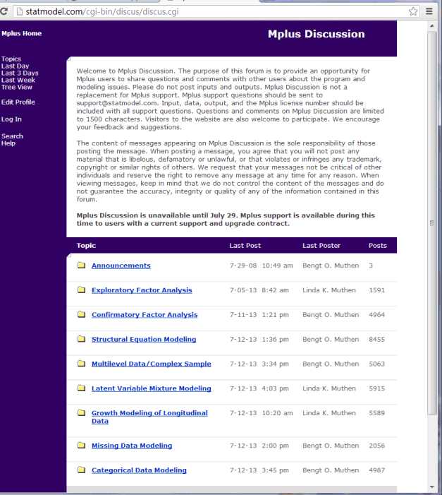
Friend 2
The statmodel forum
Notes:
* Linda & bengt – they are a couple; they actually respond quite often and quick to this forum; quite willing to help you * a lot of your questions will be on the forum (and answers) * they preferably help you when you have a license

Slide 7

Friend 3
Notes:
* Google will often redirect you to this forum

Slide 8
Today

Slide 9
Content for today
Short SEM overview
Prepare your data for Mplus
Mplus common commands + diagrammer
Simple analyses
Step-by-step checklist
Tech1
Model fit

Slide 10
SEM ~ the idea

Slide 11
Path Diagram: Graphical representation of SEM
y1
Observed variable
Construct = latent (unmeasured) variable (latent factor)
Direct effect
Covariance (no causal hypothesis)
Variance
Residual variance / measurement error
F1
vs
vs
11
Notes:
7/5/2021
11
Sem models are usually expressed graphically, and before you run your model, it can be very helpful to draw it first.
These are the elements of a SEM model
* If someone tells you he is going to do a regression model – you know what he is going to do. but sem covers a lot of different models, so what we mostly do is draw the SEM so we know the model * circle arrow = variance
Note by Duco: Replaced term causal by directed following https://pdfs.semanticscholar.org/2daf/dcc9587e92be3bef0a91d9caf11b14733767.pdf

Slide 12
Path models
A
B
A
B
C
C
Partial mediation
Multiple regression
A
C
A
B
B
C
D
Full mediation
More complex path models
Notes:
These are some path models. They are the structural relations in a sem model. Which one can you do in SPSS?
----- Notulen (6/12/13 08:06) -----
only 2 is possible in SPSS
* Only multiple regression can you do in spss (ask question who knows which ones can we do in spss) * in sem we can do all of them, (you can do almost any model, but of course it has to make sense)

Slide 13





Measurement models
$$F1$$
$$y_{1}$$
$$y_{2}$$
$$y_{3}$$
$$y_{4}$$
Notes:
This is a measurement part of the model. I hope it is familiar to everyone.

Slide 14
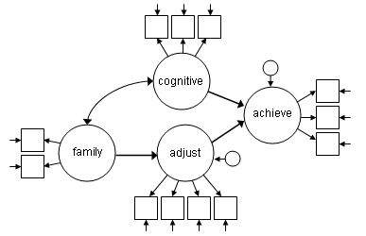
SEM
From theory to model
Extend/explore
Compare
Notes:
Translate your theory and expectations into a model
Square is observed variable, circle is latent construct, one headed arrow is causal effect, two headed arrow is covariance (no causal hypothesis)
* Compare different models * No very clear difference is made between structural and measurement part of model

Slide 15
How to evaluate this in Mplus?
Draw your model (= theory)
Get your data Mplus-ready
Make the syntax file Translate ‘ ’ into ON (B regressed ON A) Translate ‘ ’ into WITH
Run the analysis
Evaluate results (estimates / model fit) & … Check if the Mplus defaults did something unplanned
Notes:
----- Notulen (6/12/13 08:06) -----
unplanned is not neccesarily wrong, just unplanned

Slide 16
Example Data
Notes:
Today, all examples in the lectures will be based on the same example data

Slide 17

SOUTH AFRICAN PERSONALITY INVENTORY PROJECT
Carin Hill
Leon Jackson
Deon Meiring
J. Aleweyn Nel
Ian Rothmann
Michael Temane
Velichko H. Valchev
Fons J. R. van de Vijver
Nel, J. A., Valchev, V. H., Rothmann, S., van de Vijver, F. J. R., Meiring, D., & de Bruin, G. P. (2012). Exploring the personality structure in the 11 languages of South Africa. Journal of Personality, 80, 915–948.
Notes:
The South African Personality Inventory (SAPI) project aims to develop an indigenous personality measure for all 11 official languages in South Africa.
* Use this data to show all these steps

Slide 18
SOUTH AFRICAN PERSONALITY INVENTORY PROJECT
1216 participants from 11 official language groups
From about 50,000 descriptive responses to 262 personality items
Nine personality clusters:
Our data: selection of 1000 participants
Conscientiousness
Emotional Stability
Extraversion
Facilitating
Integrity
Intellect
Openness
Relationship Harmony
Soft-Heartedness (Ubuntu)
Notes:
* 11 different languages → research question: (not sure…) same results/ interpretation for 11 languages?

Slide 19

Prepare your data for Mplus
Notes:
We show this in SPSS
Who uses spss?
Excel
R
We show spss in this lecture, exercise prepared for excel as well

Slide 20
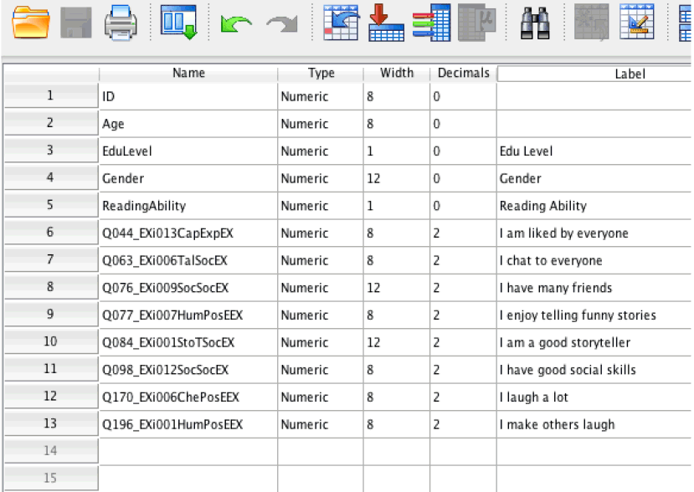
Prepare your data for Mplus
Make sure that:
1. You use decimal points -> Syntax: set locale = English.
2. SPSS leaves sufficient room between values = width ≥ 8, delete text variables
Notes:
* Do use spss? (a lot of people that we meet are familiar with spss, so that’s why we show examples in spss)
* It should be a numerical variable, no string variables (labeling is fine) * you don’t want any text in the mplus data file, just numbers

Slide 21
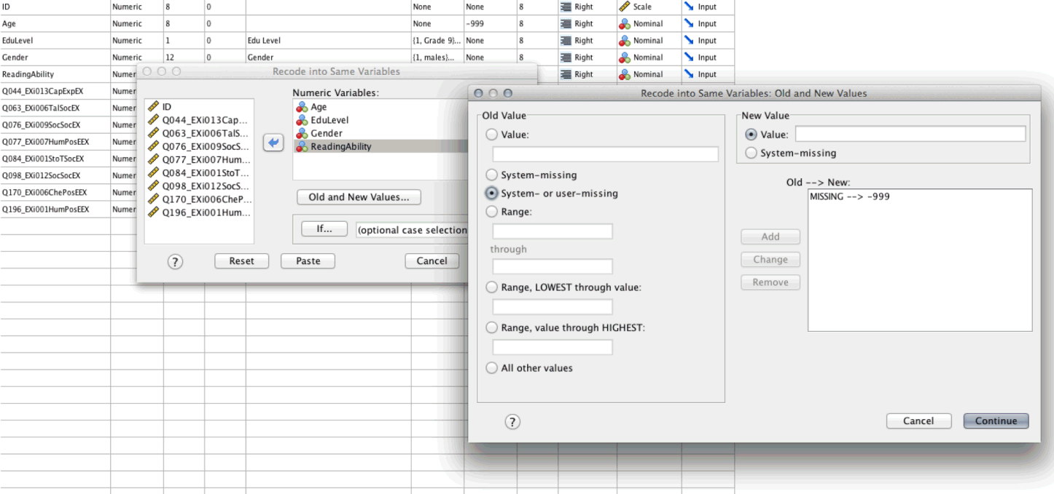
Prepare your data for Mplus
Make sure that:
3. All missing values in data are real values (-999), not empty (.) cells
Recode into same variables -> System- or user-missing -> Value -999 -> Add -> Continue
Notes:
Default for missing are dots, check in your own file what is used, it can be any value
* all missing values need to be indicated with a real value, e.g. -999 or some other value that is not naturally occurring in your data set

Slide 22
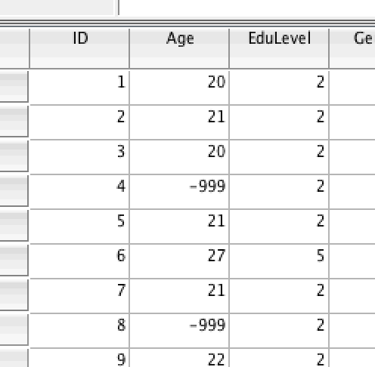
Prepare your data for Mplus
Make sure that:
3. All missing values in data are real values (-999), not empty (.) cells
Check in dataview:

Slide 23
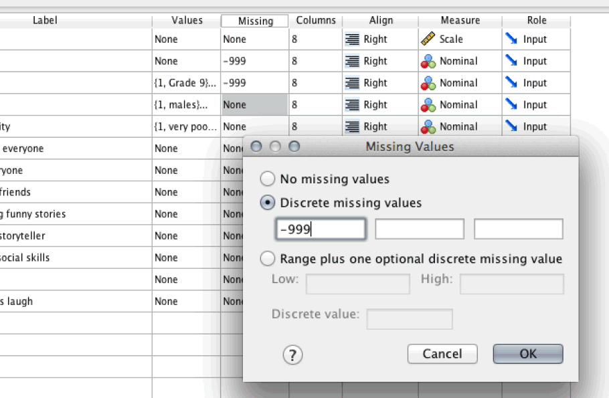
Prepare your data for Mplus
Make sure that:
3. All missing values in data are real values (-999), not empty (.) cells
- If you work with the SPSS dataset after transformation, specify new missing values here:

Slide 24
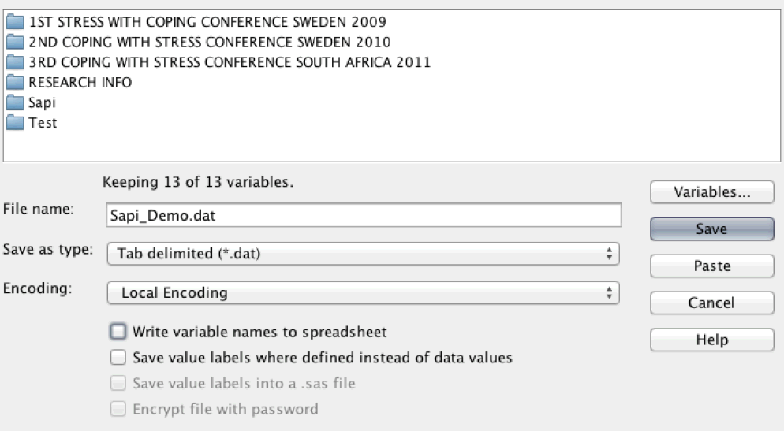
Prepare your data for Mplus
4. Make sure that you save your data in the correct way:
Type = Tab delimited (*.dat)
Uncheck ‘Write variable names to spreadsheet’
Save it in the location where you will save your syntax too
Notes:
This also shows that Mplus cannot read your data, it cannot see the difference between age and gender
* Also in this place, mplus doesn’t want variable names in the data file; only columns with numbers

Slide 25
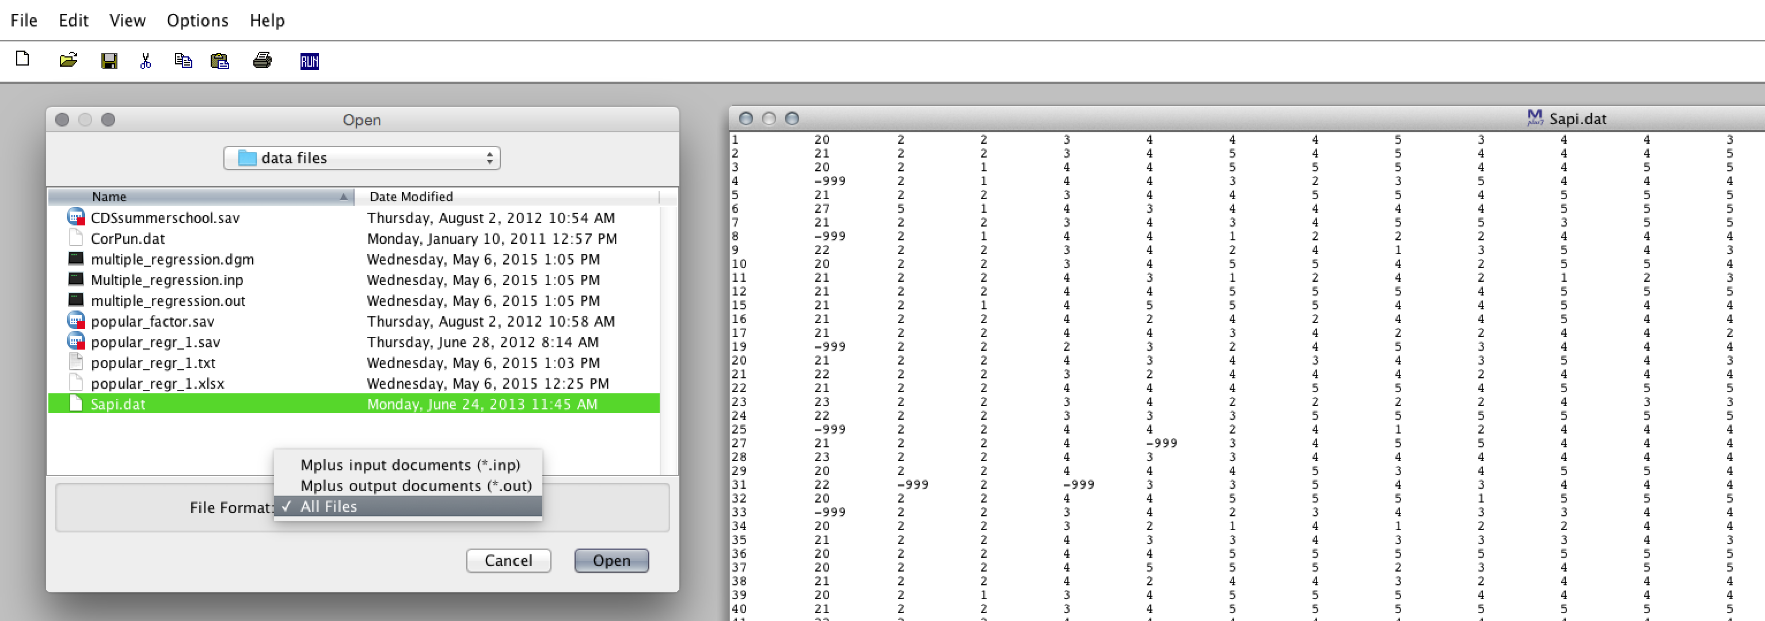
Prepare your data for Mplus
5. Check the data file:
Does it have neat columns? (see width settings in SPSS, step 2)
Are there no strange signs (upper left corner)? (if yes, manually delete them)
Notes:
* Same order is used in the file – but no variable names are included * When you look to the mplus data file you cannot see it → tricky part * later on; we tell mplus which column is which data; but if you make a mistake Mplus doesn’t know it, so in that case the analysis is carried out with the wrong variables
* sometimes, strange symbols occur in the upper left corner of the data file; delete this; mplus gives a warning when this happens * we have this data file, ready to go, want mplus run it for us

Slide 26
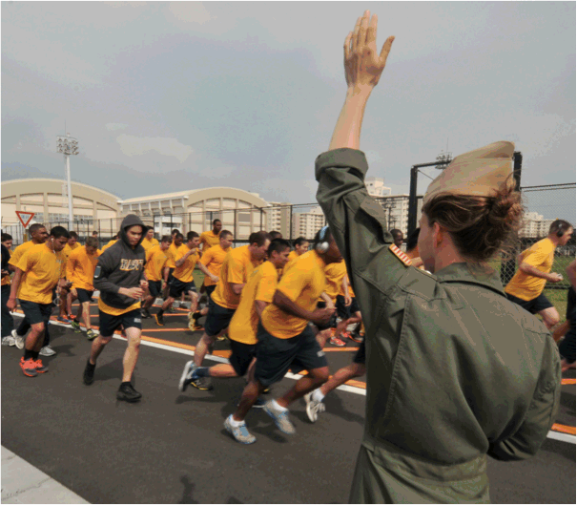
Mplus commands How to let Mplus run for you

Slide 27
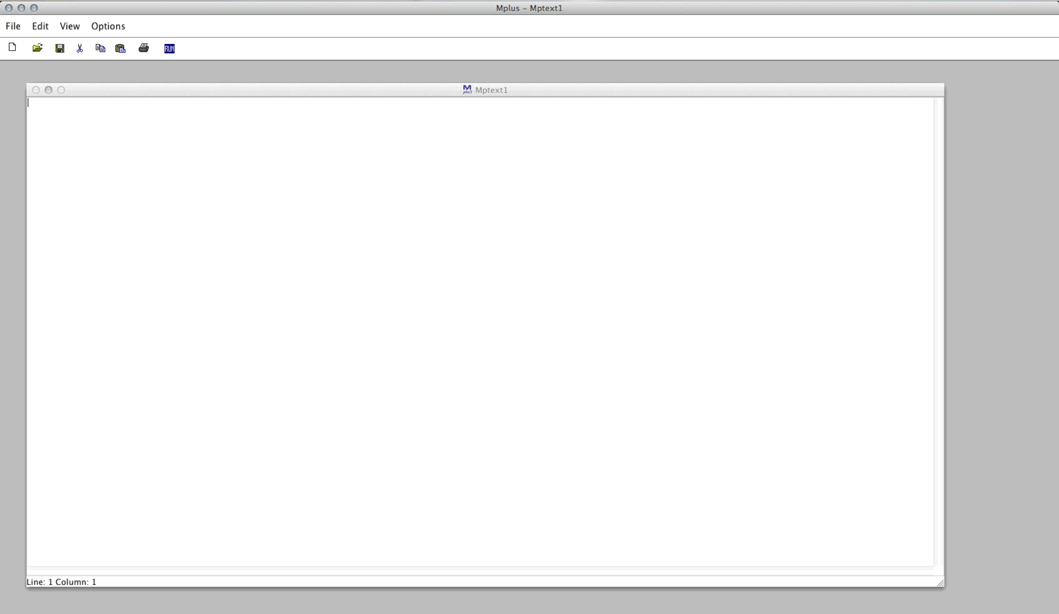
Mplus…
Notes:
* Most people get a bit afraid * It shows you just a blank file; you have to make a SEM model in it * we do it step by step * we start with this blank space

Slide 28
Mplus main commands
TITLE:
DATA: ; !(required)
VARIABLE: ; !(required)
ANALYSIS: ;
MODEL: ;
OUTPUT: ;
Notes:
* Commands – semicolons are really important ; otherwise it reads everything at one line * at some point you will forget it; always good to check this when you get a (strange) warning * only it is not obligatory with title; but it’s a good habit, title command is not obligatory but it good be nice for your own documentation * data command – need full path if data and model is not in same folder; best to save the input and data file in same place

Slide 29
Commands TITLE: & DATA:
TITLE: Useful for documenting output
DATA: FILE IS filename.dat;
! Capitals are ignored
! ‘IS’, ‘ARE’ and ‘=’ can be used interchangeably
! Note: if (and only if) the data file is in the same folder as the Mplus setup, there is no need to specify the entire path!
Notes:
Have a look at the first 2 commands: title and data * mplus doesn’t care about capitals and grammar (is/are)
Capitals are useful to read mplus files written by others.

Slide 30
Command VARIABLE:
VARIABLE: to specify variable names and types;
Example so far
TITLE: Example 1
DATA: FILE IS filename.dat;
VARIABLE: NAMES = var1 var2 x1-x6 y1 y2;
USEVARIABLES = var2 x1-x6;
MISSING = all (-999);
CATEGORICAL = x1-x4;
COUNT = x5-x6;
Notes:
----- Notulen (6/11/13 13:05) -----
names should be in the order of the file
They don’t have to be real names, the difference between names should be in the first 8 characters, mplus will only display those * here we tell mplus which variable is in which column * var1 = 1st column, x1-x6 = 6 columns at once * names = need to specify all variables included in data file; also if you don’t want to use these variables in your analysis * names = names you came up with, mplus can only read the first 8 characters of a variable name * missing = for all variables we used (-999), but you can also specify it for every variable * categorical/ count – need to specify this information, these variables follow a different distribution * continuous is default, so we don’t need to specify this * are there questions? - names = what are differences within the names of the variables → can just come up with them yourself - search button within mplus → read mplus users guide

Slide 31
Command VARIABLE:
VARIABLE: to specify variable names and types;
Example so far
TITLE: Example 1
DATA: FILE IS filename.dat;
VARIABLE: NAMES =
var1
var2
x1
x2
x3
x4
x5
x6
y1
y2;
USEVARIABLES = var2 x1-x6;
MISSING = all (-999);
CATEGORICAL = x1-x4;
COUNT = x5-x6;
Notes:
----- Notulen (6/11/13 13:05) -----
names should be in the order of the file
* You can just copy paste the variable list from spss (or other program) to mplus → trick to do your coding correctly * as long as you end with the semicolon it is fine

Slide 32
Command ANALYSIS:
ANALYSIS: to specify the type of analysis, type of estimator, number of processors, and 65 other options (Chapter 16, users guide);
ANALYSIS:
TYPE = MIXTURE / TWOLEVEL / EFA
ESTIMATOR = ML / WLSMV / BAYES / etc.
Choice of estimator depends on type of data and model
Often not required due to defaults
Notes:
ML default, WLSMV what SPSS works with (we think), Bayes = Bayesian statistics
Wlsmv = weighted least squres means and variances adjusted * ML is default one, you can specify other estimators * if you have categorical data, it might switch by default to another estimator → this will be shown in output file * I would first let mplus decide which estimator to use, see what happens and if it makes sense

Slide 33
Command MODEL:
MODEL: to specify the model that you want to analyze;
Important keywords are BY, ON, WITH
Measured BY ! → Relates to Measurement Models
Regressed ON ! → Relates to Regression / Path Models
Correlated WITH ! → often estimated by default
Specify a variance with varName;
Specify a mean with [varName];
@ to fix parameter
specify a constraint (VarName)
* to release a parameter from default, or to specify a starting value
Notes:
/ covarying with.. * BY, ON, WITH → we can make a lot of models with these three words * exclamation mark – everything behind it is ignored, so you can make notes * make sure you write the ; before the ! Otherwise this is also ignored * we don’t need this * very often; can free some constrained parameters, or for starting values * show all this with an example

Slide 34
Command MODEL:
Example so far
TITLE: Example 1
DATA: FILE IS filename.dat;
VARIABLE: NAMES = var1 var2 x1-x6 y1 y2;
USEVARIABLES = x1-x2 y2;
MISSING = all (-999);
ANALYSIS: !empty
MODEL: x1 WITH x2;
y2 ON x1 x2;
Notes:
* Exercise – draw this model based on the syntax, 30 sec. [10.38] * draw it together on the whiteboard * syntax → y2 on x1 x2, short cut, you could also write y2 on x1; y2 on x2; * there is more estimated than we see in the model input * mplus will also estimate the residual error for y2, and for x1 and x2 there will be variance * if we don’t write down x1 with x2, mplus will also estimate the correlation * good to be aware of these default

Slide 35
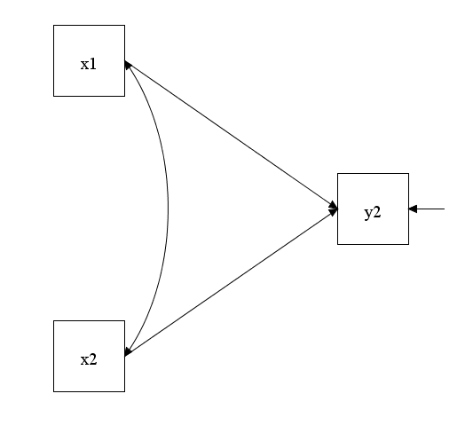
Command MODEL:
Notes:
* Exercise – draw this model based on the syntax, 30 sec. [10.38] * draw it together on the whiteboard * syntax → y2 on x1 x2, short cut, you could also write y2 on x1; y2 on x2; * there is more estimated than we see in the model input * mplus will also estimate the residual error for y2, and for x1 and x2 there will be variance * if we don’t write down x1 with x2, mplus will also estimate the correlation * good to be aware of these default

Slide 36
Command MODEL:
Example so far
TITLE: Example 1
DATA: FILE IS filename.dat;
VARIABLE: NAMES = var1 var2 x1-x6 y1 y2;
USEVARIABLES = x1-x2 y2;
MISSING = all (-999);
ANALYSIS: !empty
MODEL: x1 WITH x2;
y2 ON x1 x2;
y2; !residual variance of y2
x1 x2; !variance of x1 and x2
[y2]; !intercept for y2
[x1 x2]; !mean of x1 and x2
Notes:
* These are all things we don’t need to specify them, mplus estimates it byd efault * but it won’t show everything in the output * it won’t show by default variances of x1 and x2; add it to the input when you want to see it in the input * you may write down what you want to see in the output if you want to be in control

Slide 37
Command MODEL:
Example so far
TITLE: Example 1
DATA: FILE IS filename.dat;
VARIABLE: NAMES = var1 var2 x1-x6 y1 y2;
USEVARIABLES = x1-x2 y2;
MISSING = all (-999);
ANALYSIS: !empty
MODEL: x1 WITH x2@0;
y2 ON x1 x2;
Notes:
* Constrain relation x1 with x2 to be zero; then mplus will let go its default; but this constrained is not recommended in regression models

Slide 38
Command MODEL:
Example so far
TITLE: Example 1
DATA: FILE IS filename.dat;
VARIABLE: NAMES = var1 var2 x1-x6 y1 y2;
USEVARIABLES = x1-x2 y2;
MISSING = all (-999);
ANALYSIS: !empty
MODEL: x1 WITH x2*0;
y2 ON x1 x2;
Notes:
* Starting values; not very important, doesn’t change a lot in this case here

Slide 39
Command OUTPUT:
OUTPUT:
SAMPSTAT | Sample statistics
STDYX | Standardized solution
TECH1 | See how many and which parameters are estimated/constrained
CINTERVAL | Confidence interval
CINTERVAL(BOOTSTRAP / BCBOOTSTRAP) | CI for bootstrapped results
MOD MOD(10) | Modification Indices, to see how your model can be statistically improved
Notes:
* sampstat; can be a nice check because it will show all the means (age = -20, you know something went wrong, e.g. with names, missing data value or order of variables) * stdyx; for example this one, but there are also other types of standardized variables * tech1; shows the number of parameters → explain how much parameters there are estimated in example on whiteboard, you can check this in tech1 [if we have some additional time today we can address this topic; there is some information on the slides anyway]
* MOD; exploratory! * these are only some of the output commands; there are many more – most important are shown here; you can find all commands in the mplus users guide

Slide 40
Result
Example
TITLE: Example 1
DATA: FILE IS filename.dat;
VARIABLE: NAMES = var1 var2 x1-x6 y1 y2;
USEVARIABLES = x1-x2 y2;
MISSING = all (-999) ;
ANALYSIS: !empty
MODEL: x1 WITH x2;
y2 ON x1 x2;
OUTPUT: SAMPSTAT STDYX TECH1;
Notes:
* Shortly recap of all commands; what we see here * Do need the analysis line even If we don’t use it (??) * basically we have our first input file; went from blank space to this * any questions so far

Slide 41
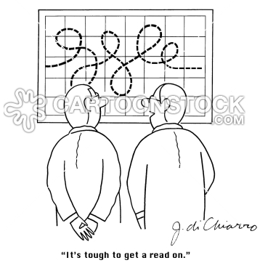
Diagrammer
Notes:
* Nice help of mplus * Maybe you’re really afraid of blank space/ input file

Slide 42
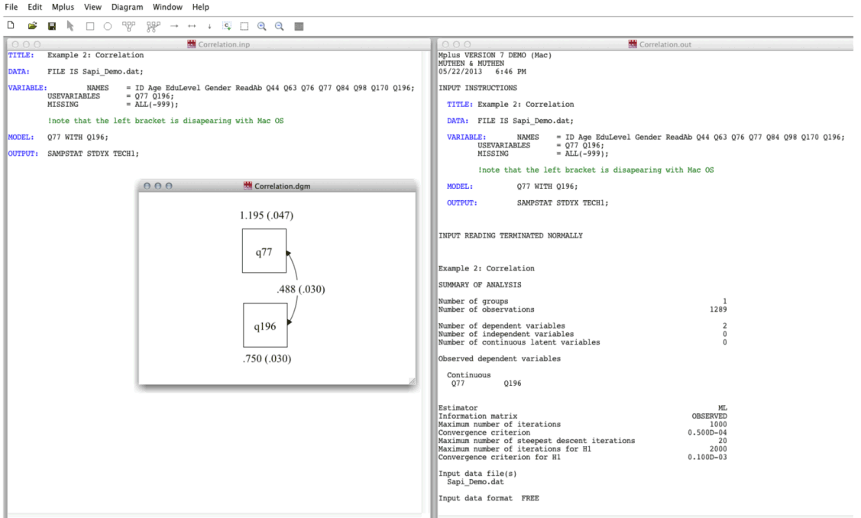
Diagrammer 1
From input as usual to diagram + output
Notes:
To check what you actually estimated (makes tech 1 unnecessary)
Default it shows unstandardized values for relations between variables and variances
You can ask for standardized values in view * different ways to use the diagrammer * could be a nice check to see what mplus did with your input * this is a nice function

Slide 43
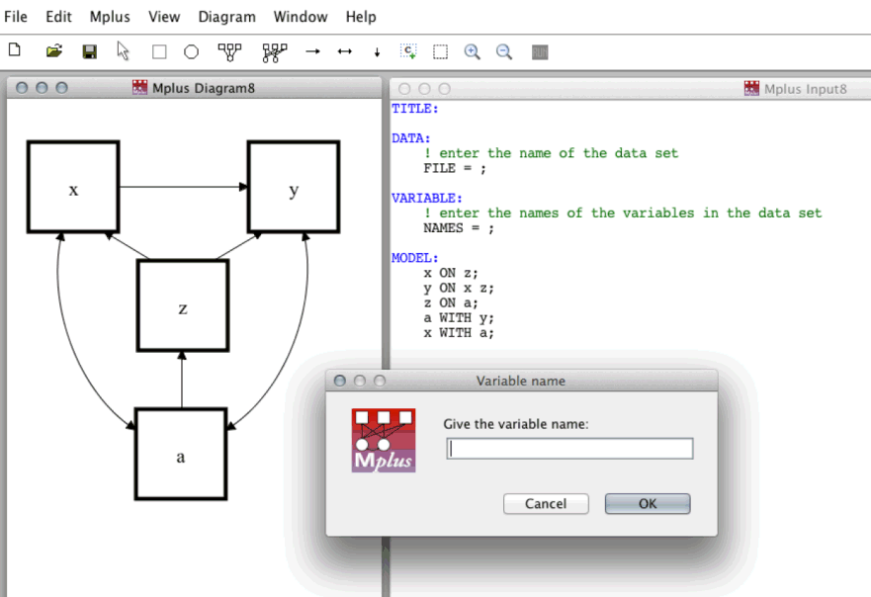
Diagrammer 2
From diagram to model input
Notes:
If you have trouble with the commands
Can you specify what the model commands look like for this model?
Y on z x;
X on z;
Z on a;
X with a;
Y with a; * you could also start with the diagrammer; draw the model, and mplus makes the syntax file

Slide 44
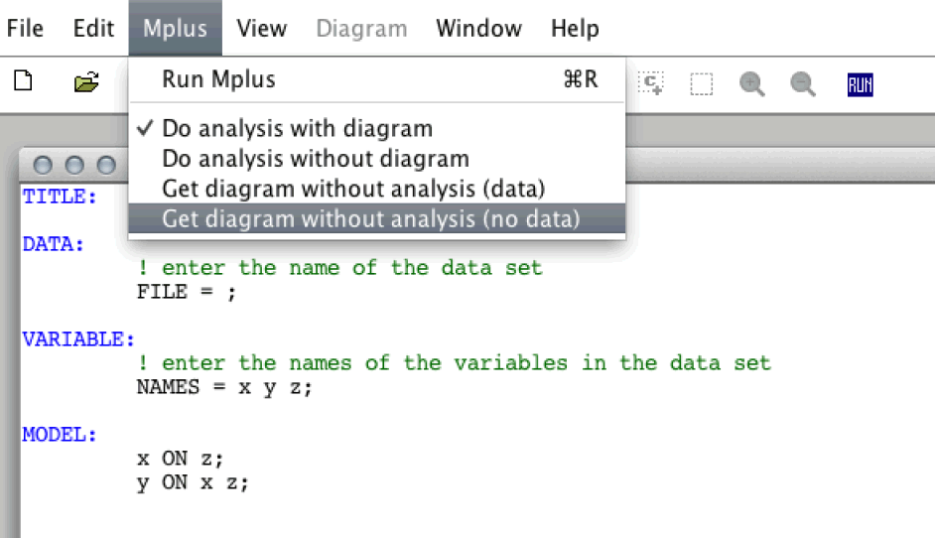
Diagrammer 3
From input to diagram without data
Notes:
To see if you’re on the right track * if you don’t have data/ don’t want to analyze the model yet; get the diagram without analysis(no data) * you can use it, doesn’t have to * mplus (muthen and Asparouhov) – didn’t want to build a diagrammer; but many people want to have it * son/ nephew build the diagrammer; its not always updated – for very simple things it works fine (with complex models diagrammer is not always available) * it’s a very nice tool but don’t expect too much from it; but it is nice to start with it * questions about the diagrammer? [10.53]

Slide 45
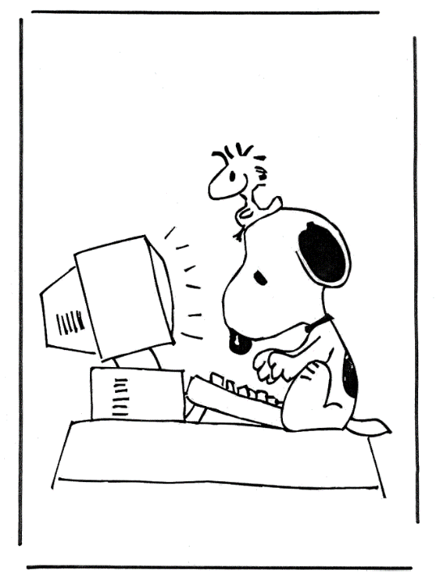
Let’s Analyze
Notes:
Analyze three simple models, to give you an idea of how it works and what the output looks like

Slide 46

Correlation
Variables:
Q77: I enjoy telling funny stories
Q196: I make others laugh
Notes:
* 2 variables from the sapi data

Slide 47
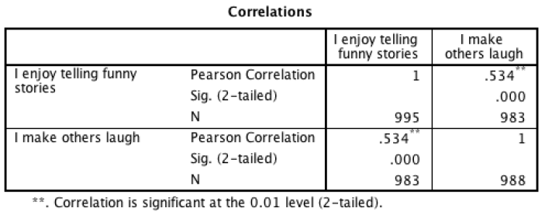
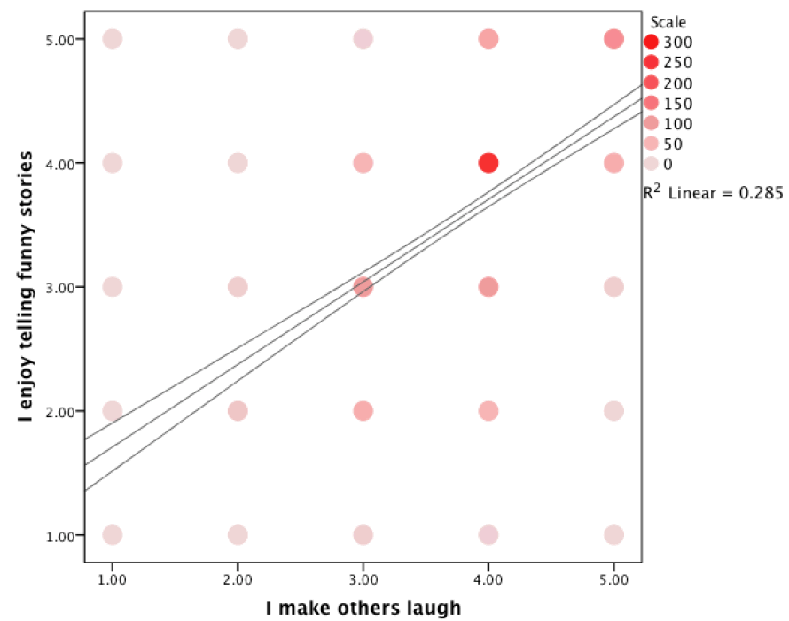
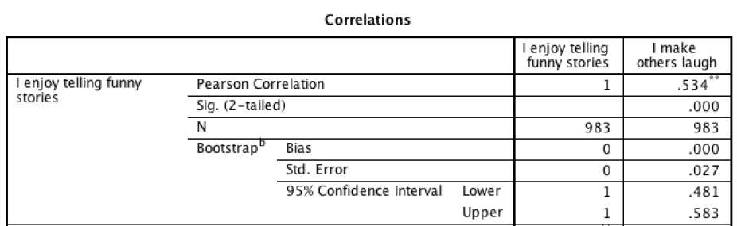
SPSS Correlation
Graphs -> Legacy Dialogs -> Scatter/Dot -> Simple Scatter
Analyze -> Correlate -> Bivariate
Notes:
Note grey area between categorical and continuous data for 5-point likert scale
Note the correlation, note the sample size (changing)
Note that bootstrap correlation is the same, n is the same as before (first part is just the same)
Bootstrap bias is zero -> Bias is the difference between the average value of this statistic across the bootstrap samples and the value in the Statistic column.
We get a standard error and a confidence interval
* Many dots are positioned at the same position * categorical/ continuous discussion – it is cat, but we want it to be continuous – assume it as cont here * spss; by default uses listwise deletion → n = 983 participants only have both cases * bootstrap, get a 95% CI * we can do this in mplus as well

Slide 48
Mplus Correlation
TITLE: Example 2: Correlation
DATA: FILE IS Sapi_Demo.dat;
VARIABLE: NAMES = ID Age EduLevel Gender ReadAb Q44 Q63 Q76 Q77 Q84 Q98 Q170 Q196;
USEVARIABLES = Q77 Q196;
MISSING = ALL(-999);
MODEL: Q77 WITH Q196;
OUTPUT: SAMPSTAT STDYX CINTERVAL TECH1;
Notes:
WITH actually asks for the covariance, that’s why we need to ask for standardized results
Why do we ask for sampstat, CI and tech1? -> dubbelcheck + CI is always good * we use with; * question: can you recall what with statement means? → covarying with * interested in correlation – you have to look at the standardized output

Slide 49
Mplus Correlation
INPUT READING TERMINATED NORMALLY
…
SUMMARY OF ANALYSIS
Number of groups 1
Number of observations 1000
Number of dependent variables 2
…
Observed dependent variables
Continuous
Q77 Q196
Estimator ML
Information matrix OBSERVED
SUMMARY OF DATA
Number of missing data patterns 3
Notes:
In the summary we find 1000 observations..
The variables and the measurement scale we gave them
Estimator is ML
Missing data is observed too * input reading termin…. → good; if you made a mistake there is something else up here * tells about number of groups, observations → summary of model * information about estimator * there are 3 missing data patterns → you can also find this information in your output file; explain what missing data patterns are * here we see 1000 observations; mplus doesn’t do complete cases analysis; if possible Mplus will use full information ML; it uses all information it can use. It probably won’t use it for independent variables [maybe later today; very last part of the slides] * mplus tells which estimator is used; and how many observations are used questions about fiml → this covariance; mplus sees x1 and x2 as dependent variables (because of the covariance), so therefore we could use fiml here (mplus thinks a latent variable is causing them)

Slide 50
Mplus Correlation
SAMPLE STATISTICS
ESTIMATED SAMPLE STATISTICS
Means
Q77 Q196
________ ________
1 3.572 3.800
Covariances
Q77 Q196
________ ________
Q77 1.181
Q196 0.505 0.758
Correlations
Q77 Q196
________ ________
Q77 1.000
Q196 0.534 1.000
Notes:
Sample statistics
Final result? The results are equal to the results that you are looking for, but this is just the place for Mplus to provide simple sample statistics, They are provided for you to double check whether everything is fine: an extreme mean could indicate that a missing value number is considered a real number, or maybe some variables got mixed up.
What you want to evaluate your model is the real model output (with indications of SE and significance of the estimate) * model results - .. With .. Covariance * in standardized results – correlation; and we can check for its statistically significant

Slide 51
Mplus Correlation
MODEL RESULTS
Two-Tailed
Estimate S.E. Est./S.E. P-Value
Q77 WITH
Q196 0.505 0.034 14.816 0.000
Means
Q77 3.572 0.034 103.714 0.000
Q196 3.800 0.028 137.397 0.000
Variances
Q77 1.182 0.053 22.306 0.000
Q196 0.758 0.034 22.231 0.000
STANDARDIZED MODEL RESULTS
STDYX Standardization
Two-Tailed
Estimate S.E. Est./S.E. P-Value
Q77 WITH
Q196 0.534 0.023 23.431 0.000
Notes:
Where can we find the correlation?

Slide 52
Mplus Correlation
CONFIDENCE INTERVALS OF STANDARDIZED MODEL RESULTS
STDYX Standardization
Lower .5% Lower 2.5% Lower 5% Estimate Upper 5% Upper 2.5% Upper .5%
Q77 WITH
Q196 0.475 0.489 0.496 0.534 0.571 0.579 0.593
Means
Q77 3.079 3.128 3.154 3.286 3.418 3.443 3.492
Q196 4.098 4.161 4.194 4.364 4.533 4.566 4.630
Variances
Q77 1.000 1.000 1.000 1.000 1.000 1.000 1.000
Q196 1.000 1.000 1.000 1.000 1.000 1.000 1.000
Notes:
95% CI

Slide 53
R²
proportion of shared/explained variance
.534² = .285 = 28.5%
Other factors
Notes:
R^2 is effect size
After our very first mplus analysis: do you have any questions?

Slide 54
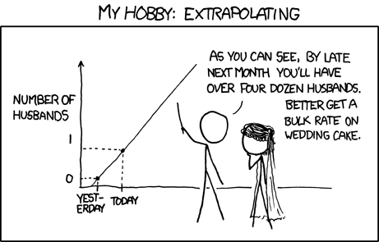
Regression
Notes:
* Start at 11.01

Slide 55
Regression
Variables:
Age
Q77: I enjoy telling funny stories
Notes:
Write down regression equation
Q77_i = B_0 + Age_i*B1 + e. e~ N(0,sigma^2)
Q77_hat = B_0 + Age_i*B1 * whether age predicts enjoy telling funny stories

Slide 56
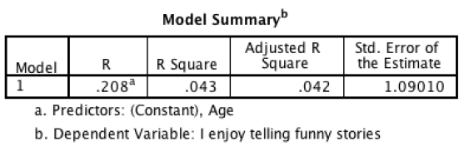
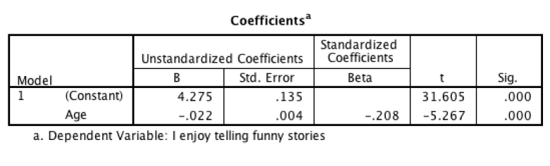
SPSS Regression
Analyze -> Regression -> Linear
Notes:
----- Notulen (6/12/13 08:04) -----
fill in equation * younger persons enjoy telling funny stories more than older people * we’re predicting fun for person i → (write on whiteboard) fun_i = int + age_i * B + e_i we don’t know the error yet, so let’s say we want to estimate the modelled version of fun: ^fun = 4.275 + age_i * -0.022 we can also look at the residuals in spss

Slide 57
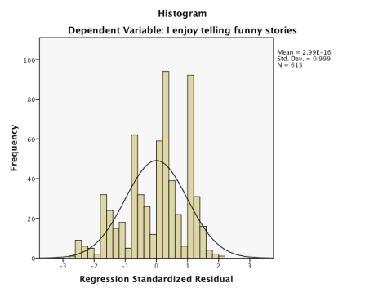
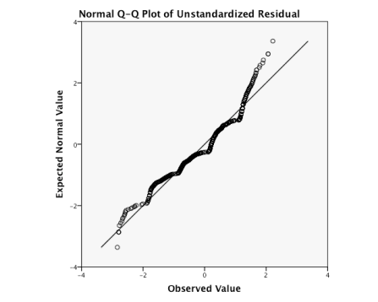
SPSS Regression
Residuals
Regression -> Linear -> Plot
Descriptives -> Q-Q plot from saved unstandardized residuals
Notes:
* In spss you can look at the residuals; mplus is a great tool – you can build great models with it * but you cannot check assumptions in mplus * you have to be aware of this * mplus is not a tool to explore your data

Slide 58
Mplus Regression
TITLE: Example 3: Regression
DATA: FILE IS Sapi_Demo.dat;
VARIABLE:NAMES = ID Age EduLevel Gender ReadAb Q44 Q63 Q76 Q77 Q84 Q98 Q170 Q196;
USEVARIABLES = Age Q77;
MISSING = ALL(-999);
MODEL: Q77 ON Age;
OUTPUT: SAMPSTAT STDYX TECH1;
Notes:
* Input in mplus

Slide 59
Mplus Regression
*** WARNING
Data set contains cases with missing on all variables.
These cases were not included in the analysis.
Number of cases with missing on all variables: 2
*** WARNING
Data set contains cases with missing on x-variables.
These cases were not included in the analysis.
Number of cases with missing on x-variables: 380
*** WARNING
Data set contains cases with missing on all variables except
x-variables. These cases were not included in the analysis.
Number of cases with missing on all variables except x-variables: 3
3 WARNING(S) FOUND IN THE INPUT INSTRUCTIONS
Number of groups 1
Number of observations 615
Estimator ML
Information matrix OBSERVED
Notes:
* Then the warnings follow * It makes sense mplus cannot estimate cases with missing values on all variables → ignore this warning * independent variable, it doesn’t apply fiml estimation technique on → so we only have 615 observations in this case (number of observations)

Slide 60
Mplus Regression
MODEL RESULTS
Two-Tailed
Estimate S.E. Est./S.E. P-Value
Q77 ON
AGE -0.022 0.004 -5.275 0.000
Intercepts
Q77 4.275 0.135 31.657 0.000
Residual Variances
Q77 1.184 0.068 17.536 0.000
R-SQUARE
Observed Two-Tailed
Variable Estimate S.E. Est./S.E. P-Value
Q77 0.043 0.016 2.697 0.007
Notes:
Equation invullen.
Note: 2-tailed p-value is voor varianties mal, liever eenzijdig toetsen!
And now we have our regression * -0.022 is the same * int is also the same * but also tells about res variance * r square is also given in spss * results are similar to spss; because mplus doesn’t used fiml, so it also used listwise deletion just as in spss [question about the number of observations – equal to spss (before a different number was shown, this causes some confusion)]

Slide 61
Mplus Path Model
Age
Q77
Q196
Q77: I enjoy telling funny stories
Q196: I make others laugh
Notes:
Q77: I enjoy telling funny stories
Q196: I make others laugh
----- Notulen (6/12/13 08:06) -----
draw the model together
* Write down the syntax yourself (and don’t peak on the next slide) * Think about the required input and optional input [1-2 min time to write this down]

Slide 62
Mplus Path Model
MODEL: Q77 ON Age;
Q196 ON Q77;
Age
Q77
Q196
Notes:
----- Notulen (6/12/13 08:06) -----
draw the model together
* This is what you really need * You could indeed also add the variances of the three variables to get the variances and residual variances * and you could also ask for the intercept of age, because this is not shown (it is shown for q77 and q196)

Slide 63
Mplus Path Model
MODEL: Q77 ON Age;
Q196 ON Q77;
MODEL RESULTS
Two-Tailed
Estimate S.E. Est./S.E. P-Value
Q77 ON
AGE -0.022 0.004 -5.295 0.000
Q196 ON
Q77 0.452 0.027 16.770 0.000
Intercepts
Q77 4.276 0.135 31.647 0.000
Q196 2.147 0.102 21.140 0.000
Residual Variances
Q77 1.185 0.068 17.530 0.000
Q196 0.546 0.031 17.489 0.000
Age
Q77
Q196
Notes:
----- Notulen (6/12/13 08:06) -----
draw the model together * the mean and variance of age is not given, mplus thinks this is not important for you

Slide 64
Standardized results + R²
STANDARDIZED MODEL RESULTS
STDYX Standardization
Two-Tailed
Estimate S.E. Est./S.E. P-Value
Q77 ON
AGE -0.208 0.038 -5.414 0.000
Q196 ON
Q77 0.563 0.028 20.298 0.000
Intercepts
Q77 3.841 0.140 27.506 0.000
Q196 2.402 0.166 14.498 0.000
Residual Variances
Q77 0.957 0.016 59.641 0.000
Q196 0.683 0.031 21.897 0.000
R-SQUARE
Observed Two-Tailed
Variable Estimate S.E. Est./S.E. P-Value
Q77 0.043 0.016 2.707 0.007
Q196 0.317 0.031 10.149 0.000
Notes:
* Standardized output * What I like about the standardized R squared = 1 – residual variance ; they always add up so that it nice feature

Slide 65
Step by step
Notes:
* Nice help of mplus * Maybe you’re really afraid of blank space/ input file

Slide 66
Step 0
Data screening
Assumption checking

Slide 67
Step 1
Get your data into Mplus

Slide 68
Step 2
Check and double check if step 1 went well

Slide 69
Step 3
Draw your model

Slide 70
Step 4
Translate your drawing into Mplus syntax

Slide 71
Step 5
Check with diagrammer or even better with Tech 1 if Step 4 went well

Slide 72
TECH1?
Notes:
* Nice help of mplus * Maybe you’re really afraid of blank space/ input file

Slide 73

SEM behind the scenes
Notes:
We’ve discussed SEM graphics, and some SEM models, how to prepare data for Mplus, the Mplus commands, we’ve looked at some simple models in Mplus and Spss, we explored Mplus model fit indices and model comparisons. From this point on you can run Mplus models, but to understand outcomes and Mplus output it is good to have a little look behind the scenes
* Continue with the behind scenes part * Bit technical

Slide 74


Slide 75
Why pay attention
To know something about Mplus defaults = what happens to your model
To understand Mplus warnings THE STANDARD ERRORS OF THE MODEL PARAMETER ESTIMATES COULD NOT BE COMPUTED. THE MODEL MAY NOT BE IDENTIFIED. CHECK YOUR MODEL. PROBLEM INVOLVING PARAMETER 13.
To make use of FIML for handling missing data
Notes:
Refer to day 2 where Peter will tell more about FIML
* It’s nice if you can find out what parameter 13 is (still could be nice to see a statistican at some point}

Slide 76
Data, model & TECH1
Unique elements var-covar matrix = p(p+1)/2 (+p for means) - elements estimated in model = df
Notes:
Basic equation with respect to the data, your model and tech 1 / the df in the model fit

Slide 77
Data, model & TECH1: Saturated model
Data
Model
 | A | B | C | D
A | σ²_{A}
B | σ_{BA} | σ²_{B}
C | σ_{CA} | σ_{BC} | σ²_{C}
D | σ_{DA} | σ_{DB} | σ_{DC} | σ²_{D}
A
B
S =
C
D
How many:
Unique elements (knowns:10)
Model parameters (unknowns:10)
df (0)
Notes:
* Ask how much unique elements; model; df Data: 10+4 → 10 elements
Model: 14 → 10; 6 cross relations; 4 variances
Df: 0
* We have perfect fit, but 0 df

Slide 78
Data, model & TECH1: Saturated model
TECHNICAL 1 OUTPUT
PARAMETER SPECIFICATION
NU
AGE READAB Q44 Q63
________ ________ ________ ________
1 1 2 3 4
THETA
AGE READAB Q44 Q63
________ ________ ________ ________ ________
AGE 5
READAB 6 7
Q44 8 9 10
Q63 11 12 13 14
Notes:
Saturated model
How many df? * model = 10, estimated parameters =10 and this is true BUT * if you’re also interested in mean structure of data → p(p+1)/2 + mean Mplus shows it in vector nu * not the estimate, mean age is not 1 this is an indicator mplus uses for this mean warning mplus about parameter 1, it is about mean of age theta var-cov residuals from the name we know whether it is a latent/ obverved variables nu and theta → observed variables → we estimated all variances and covariances + means = 14

Slide 79
Data, model & TECH1: Saturated model
Number of Free Parameters 14
Loglikelihood
H0 Value -5912.034
H1 Value -5912.034
Information Criteria
Akaike (AIC) 11852.068
Bayesian (BIC) 11920.777
Sample-Size Adjusted BIC 11876.312
(n* = (n + 2) / 24)
Chi-Square Test of Model Fit
Value 0.000
Degrees of Freedom 0
P-Value 0.0000
RMSEA (Root Mean Square Error Of Approximation)
Estimate 0.000
90 Percent C.I. 0.000 0.000
Probability RMSEA <= .05 0.000
CFI/TLI
CFI 1.000
TLI 1.000
Chi-Square Test of Model Fit for the Baseline Model
Value 126.562
Degrees of Freedom 6
P-Value 0.0000
SRMR (Standardized Root Mean Square Residual)
Value 0.000
Notes:
* Model fit * Number of free parameters = mplus saying I estimated 14 parameters
* Log H0 and H1 are the same = estimated and observed model have the same fit; makes sense because we estimated the same model * chi square = 0; because we had perfect fit; we had 0 df, because of this saturated model; p value is not a serious p value, ignore this, we have perfect fit * RMSEA = also 0; perfect model * TLI and CFI = exactly 1 ; perfect model
→ this is what you will see for a saturated model(loglik could be different and AIC/BIC)

Slide 80
Data, model & TECH1: Baseline model
Variables: Age, readab, Q44, Q63, Q76. How many unique elements?
5(5+1)/2 + 5 = 20
Baseline model = Unrelated variables How many model parameters?
5 variances and 5 means = 10 parameters
How many df?
df = 20-10=10
A
B
C
D
*** WARNING in MODEL command
All variables are uncorrelated with all other variables in the model.
Check that this is what is intended.
1 WARNING(S) FOUND IN THE INPUT INSTRUCTIONS
Notes:
How many df?
Graph is just an illustration of ‘unrelated’ variables, because we have one extra variable
* question: In case of 5 variables, how many unique elements: 5(5+1)/2 + 5 = 20 * but in baseline model, all parameters are uncorrelated: question – do you know how much parameters will be estimated? 5 variances and 5 means = 10 parameters * df = 20-10=10 * and we get this warning

Slide 81
Data, model & TECH1: Baseline model
Observed variable
NU = Means / Intercepts
THETA = Variances & Covariances for residuals of observed variables
TECHNICAL 1 OUTPUT
PARAMETER SPECIFICATION
NU
AGE READAB Q44 Q63 Q76
________ ________ ________ ________ ________
1 1 2 3 4 5
THETA
AGE READAB Q44 Q63 Q76
________ ________ ________ ________ ________
AGE 6
READAB 0 7
Q44 0 0 8
Q63 0 0 0 9
Q76 0 0 0 0 10
Notes:
Baseline model
How many df?
* Discuss nu and theta

Slide 82
Data, model & TECH1: Baseline model
Number of Free Parameters 10
Loglikelihood
H0 Value -7549.696
H1 Value -7407.996
Information Criteria
Akaike (AIC) 15119.392
Bayesian (BIC) 15168.470
Sample-Size Adjusted BIC 15136.709
(n* = (n + 2) / 24)
Chi-Square Test of Model Fit
Value 283.401
Degrees of Freedom 10
P-Value 0.0000
RMSEA (Root Mean Square Error Of Approximation)
Estimate 0.165
90 Percent C.I. 0.149 0.182
Probability RMSEA <= .05 0.000
CFI/TLI
CFI 0.000
TLI 0.000
Chi-Square Test of Model Fit for the Baseline Model
Value 283.401
Degrees of Freedom 10
P-Value 0.0000
SRMR (Standardized Root Mean Square Residual)
Value 0.130
Notes:
* We don’t deviate from the baseline model, because we estimated the baseline model → CFI and TLI =0

Slide 83
Data, model & TECH1: Model to TECH1
NU
A B C
________ ________ ________
1 1 2 3
THETA
A B C
________ ________ ________
A 4
B 5 6
C 0 7 8
A
B
C
Notes:
How many elements?
How many estimated parameters?
How many df? *[skipped question about how many elements/ param/ df] * No relation between A and C → zero in theta matrix

Slide 84
Regression
©Zondervan-Zwijnenburg

Slide 85
Regression: Model in TECH1
NU = Means / intercepts
THETA = Variances & Covariances for residuals and observed variables
Beta = Regression slopes
Hypothetical TECH 1:
NU
B A
________ ________
1 1 2
THETA
B A
________ ________
B 3
A 0 4
BETA
B A
________ ________
B 0 5
A 0 0
A
B
Mplus does not have continuous
observed variables
in the structural part of model!
Notes:
* Sometimes mplus estimates more parameters * You can only find this by calculating the df yourself * and check this with the number of df given in fit index * I don’t like it when mplus don’t tell me what it does; but its not a big problem If an extra parameter was estimated, it would be nice if you get the results (you paid for it with a degree of freedom)
➔ Not clear to me

Slide 86
Regression: Model in TECH1
Mplus treats all observed y (here A and B) as latent
To do so it defines new latent variables FA and FB (internally)
Loadings 1
Intercepts of y’s 0
Residual variances of y’s 0
Result: latent A and B have mean/intercept and variance/residual of observed A and B
FA
FB
1
1
A
0
B
0
0
0
Notes:
*technical things that play in the background

Slide 87
Regression: Model in TECH1
Reality:
NU = Means / intercepts
THETA = Variances & Covariances for residuals of observed variables
Latent:
Beta = Regression slopes
Alpha = Means latent variables
Psi = Variance-Covariance matrix latent variables
Lambda = Factor loadings
FA
FB
A
B
=
1
1
A
0
B
0
0
0
Notes:
* Sometimes you think something will happend in antoher way than expected
→ Changed the matrix the parameters are within

Slide 88
Regression: Model in TECH1
Reality:
MODEL: B ON A;
ALPHA
B A
________ ________
1 1 0
BETA
B A
________ ________
B 0 2
A 0 0
PSI
B A
________ ________
B 3
A 0 0
FA
FB
1
1
A
0
B
0
0
0
Notes:
Alpha = intercept
Beta = slope – regression coefficients
Psi = residual variance
* When things are latent (and here on the background mplus makes it latent) →

Slide 89
Regression: Warning
*** WARNING
Data set contains cases with missing on all variables.
These cases were not included in the analysis.
Number of cases with missing on all variables: 4
*** WARNING
Data set contains cases with missing on x-variables.
These cases were not included in the analysis.
Number of cases with missing on x-variables: 378
*** WARNING
Data set contains cases with missing on all variables except
x-variables. These cases were not included in the analysis.
Number of cases with missing on all variables except x-variables: 2
3 WARNING(S) FOUND IN THE INPUT INSTRUCTIONS
Number of groups 1
Number of observations 616
Notes:
With this default specification, we have almost 400 missings

Slide 90
Regression: User in control
Model:
!Measurement model
FA by A@1; !factor 1
FB by B@1; !factor 2
[A@0 B@0]; !item intercepts@0
A@0 B@0; !item res. var. @0
!SEM
FB ON FA; !regression
[FA FB];
FA FB;
FA
FB
@1
@1
A
@0
B
@0
@0
@0
Notes:
Specify the dafaults ourselves and add the mean and variance of (F)A
* Can specify everything yourself; but this is not necessary

Slide 91
Regression: Model in TECH1
User in control specification:
ALPHA
FB FA
________ ________
1 1 2
BETA
FB FA
________ ________
FB 0 3
FA 0 0
PSI
FB FA
________ ________
FB 4
FA 0 5
FA
FB
1
1
A
0
B
0
0
0
Notes:
Alpha = intercept
Beta = slope
Psi = residual variance

Slide 92
Regression: Warning
*** WARNING
Data set contains cases with missing on all variables.
These cases were not included in the analysis.
Number of cases with missing on all variables: 4
1 WARNING(S) FOUND IN THE INPUT INSTRUCTIONS
SUMMARY OF ANALYSIS
Number of groups 1
Number of observations 996
Notes:
* No fiml used I guess??

Slide 93
Regression: Model in TECH1
FA
FB
Enables FIML
Otherwise listwise deletion
Same results
Sample statistics - estimates TECH 1 = df ✓
1
1
A
0
B
0
0
0
Model: B ON A;
A;
Notes:
Not true anymore? As much fiml with as without this statement?!! * we just ask for the variance of A, then mplus makes it latent and uses FIML as well * this is extra now
[skip other slides until take home message]

Slide 94
Syntax, TECH1 -> df
Y3 ON y2 x1 x2;
Y2 ON z1 w4;
K ON x1 x2;
K
Y3
Y2
x1
x2
z1
w4
Model according to TECH1
35 sample statistics
14 estimated
df =
21 7? 14 missing?
Notes:
Means of dependent
7 more estimated? Variances independents?
Expliciet opvragen expliciet op 0

Slide 95
Syntax, TECH1 -> df
Y3 ON y2 x1 x2;
Y2 ON z1 w4;
K ON x1 x2;
K
Y3
Y2
x1
x2
z1
w4
[X1 X2 Z1 W4];
Model actually estimated by Mplus
Notes:
Means of dependent
7 more estimated? Variances independents?
Expliciet opvragen expliciet op 0

Slide 96
Take home message
In a regression between observed variables, Mplus:
Transforms observed continuous variables to latent variables
By default secretly estimates
the means and variances of independent observed variables
Mplus also always secretly estimates by default:
Covariances between independent variables

Slide 97
Take home message
Know what’s happening:
Check whether sampstat – estimated = df
Get to know Mplus defaults
Read warnings (!)
Make use of FIML (if possible)
Specify latent variables
Notes:
* But the more complex your model will become, the more of this will happen by default

Slide 98
Overview TECH1
N Nu, vector with means/intercepts of observed variables
Λ Lambda, matrix with factor loadings relating observed variables to latent variables
Θ Theta, variance-covariance matrix of residuals of observed variables
α Alpha, vector with intercepts/means of latent variables
β Beta, matrix with structural parameters
Ψ Psi, variance-covariance matrix of latent variables’ residuals: variances of exogenous, and residual variances of endogenous
Notes:
* Also shortly pointed out
[13.00]

Slide 99
Step by step
Notes:
* Nice help of mplus * Maybe you’re really afraid of blank space/ input file

Slide 100
Step 6
What to do with missing data?
*** WARNING
Data set contains cases with missing on x-variables.
These cases were not included in the analysis.
Number of cases with missing on x-variables: 514
1 WARNING(S) FOUND IN THE INPUT INSTRUCTIONS
Notes:
Think about it. Maybe consider FIML, or MI.

Slide 101
Step 6
Understand all errors/warnings
Not all warning messages have to be fixed but know what the problem is.

Slide 102

Errors and Warnings
Notes:
* Mplus is also famous because of it errors/ warnings

Slide 103
Errors & Warnings
*** WARNING in Model command
All variables are uncorrelated with all other variables in the model. Check that this is what is intended.
1 WARNING(S) FOUND IN THE INPUT INSTRUCTIONS
Did you specify the usevariables command?
Notes:
* It could be that you intended this to do * It finds that what you specify is a baseline model; strange to do * often occurs that you didn’t specify the usevariables command

Slide 104
Errors & Warnings
*** WARNING in Model command
All variables are uncorrelated with all other variables in the model. Check that this is what is intended.
1 WARNING(S) FOUND IN THE INPUT INSTRUCTIONS
No model specified
Notes:
If it concerns some variables, you may forgotten the usevariables syntax

Slide 105
Errors & Warnings
*** WARNING
Variable name contains more than 8 characters.
Only the first 8 characters will be printed in the output. Variable: THISVARIABLENAMEISTOOLONG

Slide 106
Errors & Warnings
*** WARNING
Variable name contains more than 8 characters.
Only the first 8 characters will be printed in the output. Variable: THISVARIABLENAMEISTOOLONG
No problem as long as you don’t have the same first 8 letters as the variable name,
as in:
Names is THISVARIABLENAMEISTOOLONG1, THISVARIABLENAMEISTOOLONG2;
Notes:
* You can write long names – but only okay if the first 8 characters are different

Slide 107
Errors & Warnings
*** WARNING
*** ERROR in Model command
Unknown variable(s) in a BY statement: C1-C3

Slide 108
Errors & Warnings
*** WARNING
*** ERROR in Model command
Unknown variable(s) in a BY statement: C1-C3
Names, usevariables or ;
Notes:
* Maybe you didn’t use it in the usevariables; or a typo (should be d1-d3 for example) * warnings give you often a good indication of where you should look

Slide 109
Errors & Warnings
*** WARNING
*** ERROR in Model command
Unknown variable(s) in a BY statement: C1-C3
Names, usevariables or ;
*** WARNING
Categorical variable Q77 contains non-integer values.
Notes:
* If you for example have a value of .3 in your data; that’s strange for a categorical variable

Slide 110
Errors & Warnings
*** WARNING
*** ERROR in Model command
Unknown variable(s) in a BY statement: C1-C3
Names, usevariables or ;
*** WARNING
Categorical variable Q77 contains non-integer values.
Sure it’s categorical?

Slide 111
Errors & Warnings
; ?
Dots?
No empty cells?
Correct data name?
Data file stored where input file is stored?
No variable names on the first row of your data?
Correct number of variable names specified?
Notes:
If you get errors and warnings, check the following: * add: open data file within mplus to check the data file (strange symbols in the left upper corner)

Slide 112
Errors & Warnings
THE MODEL ESTIMATION TERMINATED NORMALLY
Notes:
* If you did everything correctly, this will be the first sentence of your output file * important: read the warnings; don’t ignore them → try to keep reading the warnings

Slide 113
Errors & Warnings
THE MODEL ESTIMATION TERMINATED NORMALLY
Or not..
Notes:
* Sometimes it seems that everything looks okay but something goes wrong (it can still happen you misspecified the columns; or mplus didn’t estimate everything you want to)

Slide 114
Step by step
Notes:
* Nice help of mplus * Maybe you’re really afraid of blank space/ input file

Slide 115
Step 7
Are you really really sure if everything went well?

Slide 116
Step 8
Interpret results

Slide 117

Model
Notes:
We have looked at some basic analyses and their results, but what is often interesting in SEM models is model fit * we could look at the model fit; if you’re ready (let me know if we’re going to fast) → coffee break (11.12-11.18)

Slide 118
Model Test and Fit Indices
Log likelihood
Log-likelihood ratio (Chi-Square) test
RMSEA
CFI/TLI
Chi-Square Test of Model Fit for the Baseline Model
SRMR
Information Criteria: AIC, BIC
Notes:
Fit of the data given the parameter estimates
Root mean squared error of approximation
Comparative fit index / tucker lewis index
Standardized root mean square residual
Akaike information criterion / Bayesian information criterion
* error in the model (e_i) in model on whiteboard → important part of model fit * there are 100 or even 1000 fit indices; here we provide 8 * mplus provides 10 fit indices – it makes the selection for you of what it thinks is useful [say something about this differs per estimator] * can choose to not look at the formulas but just listen how to interpret the model fit

Slide 119
A good fit index..
Not sensitive to sample size
Sensitive to discrepancies between modeled data and observed data
Reflects the degree of parsimony of the model
Perfect Model
WorstModel
Notes:
Saturated versus Baseline
Saturated perfect: variables are somehow related
Baseline: variables are completely unrelated
Compare the fit of the data with your own model to the fit of the data with the perfect or worst model * we want that a good fit indix .. (3 things on slide) * you can always make a perfect model, this is not hard; if you include all predictors in the model; it is not very interesting if we have a model with 100 variables and everything correlates with everything somehow; that’s not really interesting - * its good to give credits for being parsimonious * and besides; you don’t want to overfit the data; you can predict the data set you have perfectly, but there can be error in your data – there can be some measurement error, or some randomness; you might be over interpreting the data you have (you’re predicting all noise) ; even if the fit is a bit less good because of this * that’s what we want in fit index

Slide 120
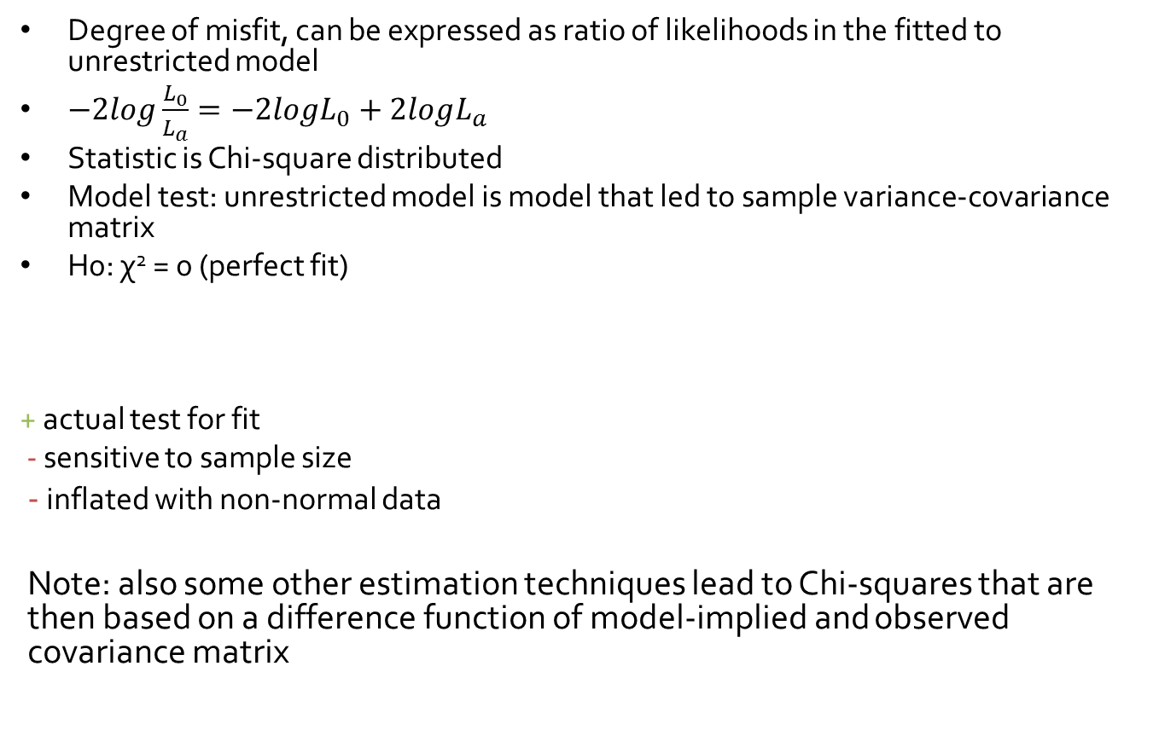
Log-likelihood ratio test
Degree of misfit, can be expressed as ratio of likelihoods in the fitted to unrestricted model
$−2log\frac{L_{0}}{L_{a}}=−2logL_{0}+2logL_{a}$
Statistic is Chi-square distributed
Model test: unrestricted model is model that led to sample variance-covariance matrix
H0: χ² = 0 (perfect fit)
+ actual test for fit
- sensitive to sample size
- inflated with non-normal data
Note: also some other estimation techniques lead to Chi-squares that are then based on a difference function of model-implied and observed covariance matrix
Perfect Model
Notes:
----- Notulen (6/12/13 08:42) -----
do we want to find p > or < than .05?
The note: does it refer to not-ML fit indices?
* Misfit * Follows a chi-square distribution; with this information we can test whether the misfit is significant * chi square value = 0 = zero misfit * in this case we didn’t want a significant chi square – this indicates a bad fit * large sample size; “what is large” → couple of 100 observations; you will often see it is significant; even your model is pretty okay * disadvantage of this fit index
* delete note → not very important

Slide 121
Correlation & Covariance
Correlation Matrix ABC
Covariance Matrix ABC
 | A | B | C
A | 1
B | r_{BA} | 1
C | r_{CA} | r_{BC} | 1
 | A | B | C
A | σ²_{A}
B | σ_{BA} | σ²_{B}
C | σ_{CA} | σ_{BC} | σ²_{C}
Notes:
Step back: short look at variance-covariance matrices. * correlation matrix – behind many of fit indices * in covariance matrix – you can always summarize your data → if you use all these information, perfect fit (everything correlates with everything) P (P+1)/ 2 = size of covariance matrix; number of elements in covariance matrix interesting to know because it can help to count degrees of freedom If we use all variables → we have no degrees of freedom left but if we model no relation between b&c; we lose a bit of our good fit, but we get 1 degree of freedom

Slide 122


Model-implied cov-matrix vs. perfect fit
Perfect-model to worse: compare S to $\hat{Σ}$
Population: $Σ$, estimated by sample data: S
Data
Model-implied
 | A | B | C
A | s²_{A}
B | s_{BA} | s²_{B}
C | s_{CA} | s_{BC} | s²_{C}
 | A | B | C
A | σ²_{A}
B | σ_{BA} | σ²_{B}
C | σ_{CA} | σ_{BC} | σ²_{C}
$\hat{Σ}=$
S =

Slide 123
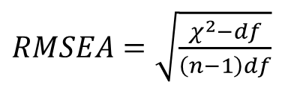
RMSEA
RMSEA (Root Mean Square Error of Approximation)
Absolute index:
Index of discrepancy between model and data
+ sensitive to model complexity, bias correction by (-df)
- less suitable with small sample size (with low df)
Rule of thumb: <.08 (mediocre), <.05 (close / good)
Inspect CIs
$RMSEA=\sqrt{\frac{χ^{2}−df}{\left(n−1\right)df}}$
= bias-corrected estimate of divergence of model-implied and population var-covar matrix
Perfect Model
Notes:
Index of the amount of misfit per degree of freedom in the model. The amount of misfit (noncentrality parameter) is the value of the chi-square above and beyond the expected value (df). This is divided by n-1 to remove the effect of sample size
p-close = p-value of test for close fit.
Interesting about the RMSEA is that it does assume that even in the population there will be a discrepancy between model and data. No model ever fits perfectly. So we don’t test whether RMSEA is significantly larger than zero (Amos computes this test too, reports it as the p-value of the RMSEA), but whether it is smaller than some small number 0.05, which is taken as an indication of close fit (Amos labels the p-value from this test as p-close).
Note: if chi-square < df then RMSEA is set to zero.
* More misfit with more degrees of freedom * You may have some misfit, but we correct for the degrees of freedom you have left (some correction) * you want this to be small; it compares to the perfect model and we want this to be a small difference * less suitable with small samples → minor disadvantage * references – rule of thumb → I cannot give you one reference for this, often used in a lot of text book; quite common knowledge; I think you don’t really need references for this; common used.

Slide 124
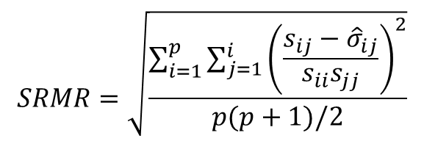
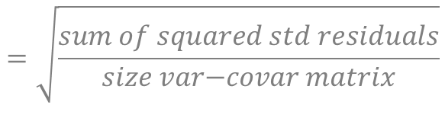
SRMR
Standardized Root Mean Square Residual
Absolute index:
Index of discrepancy between model and sample statistics
- sensitive to sample size
- insensitive to model complexity
Rule of thumb: max .08
$$SRMR=\sqrt{\frac{\sum_{i=1}^{p}{\sum_{j=1}^{i}{{\left(\frac{s_{ij}−{\hat{σ}}_{ij}}{s_{ii}s_{jj}}\right)}^{2}}}}{p(p+1)/2}}$$
$$=\sqrt{\frac{sum of squared std residuals}{size var\text{−}covar matrix}}$$
Perfect Model
Notes:
Sum over residuals divided by number of sample statistics * not including df in this model → insensitive to model complexity * what are the positive sides of this measure???? {look this up} → but its not a great fit measure; sometimes it is used; and mplus thinks its worthy to put it in the output file

Slide 125


Baseline model approach
Assume unrelated variables (independence)
Assess improvement of fit by hypothesized model
Independence model
Model-implied
 | A | B | C
A | σ²_{A}
B | 0 | σ²_{B}
C | 0 | 0 | σ²_{C}
 | A | B | C
A | σ²_{A}
B | σ_{BA} | σ²_{B}
C | σ_{CA} | σ_{BC} | σ²_{C}
${\hat{Σ}}_{b}=$
$\hat{Σ}=$
Notes:
How many df? * we can also compare to the worst model (instead of the perfect model) * worst model = all variables are uncorrelated * and we want to see how much better we do with our interesting model * if the covariances are really small in the data set; the worst model doesn’t do much worse than the specified model

Slide 126
CFI/TLI
Comparative indices:
TLI (Tucker-Lewis Index)
+ complexity
- somewhat sensitive to small sample
- works only with ML estimator
- >1 = overfitting, more complex than needed
Rule of thumb: >.90 (acceptable), >.95 (good)
CFI (Comparative Fit Index)
+ complexity
+ not sensitive to small sample size
+ consistent over different estimation methods
Rule of thumb: >.90 (acceptable), >.95 (good)
WorstModel
Notes:
Worst model is not always that bad, depends on the strength of the correlations between variables in the model * they use the same elements but do it a different way * df are added to give credits for parsimonious models *

Slide 127
Which to use?
Report several indices of different types (CFI, RMSEA)
All others than chi-square should look good
Improve the model (exploratory!) by removing n.s. paths, adding significant paths (Mod Indices), but only if: it makes theoretical sense, and: you report your modifications
Perfect Model
WorstModel
Notes:
Be aware that the indices are indications of general fit: there may be local differences.
Evaluate fitted residuals, modification indices, and standard errors. (Todd Little) * what do we want to report - we use a bit of everything * not a large problem when chi square is significant; report it (people want to see it), but its not a big problem when this is significant * what you can do is improve the model → mplus can give you hints about this (by modification indices) where it says e.g. if you add x1 with x2, your model will improve with … ; chi square value will more or less decrease with … → very very important that it makes sense → and mention it is exploratory this is important to write down; you’re improving the fit; you might be overfitting the data (it could happen it looks interesting and makes sense theoretically; but then it is important for people to know this has to be cross validated in another sample)
* questions? [11.38]

Slide 128
Relative indices: AIC/BIC
Information theoretic: Combine goodness of fit (χ²) and parsimony (number of parameters k)
AIC (Akaike Information Criterion)
BIC (Bayesian Information Criterion)
No rule of thumb, values depend on actual data set
Choose the model with the lowest AIC and/or BIC
Perfect Model
+ penalty for extra parameters / n
Notes:
----- Notulen (6/12/13 08:42) -----
what is better: lower or higher? * relative indices – AIC and BIC * combination of fit and parsimony (penalty for adding extra parameters) * but you can only use them in comparison to other models with the same number of variables and same data! * they have to be based on the same variance-covariance matrix; that is really important! * no rule of thumb; values depend on actual data set; can only use this if you have more than 1 model to test * lower is better

Slide 129
Model Comparisons
If and, and only if, the covariance matrix is equal over models = same participants, same variables
Nested models: Chi-square difference test / AIC / BIC
Non-nested models: AIC / BIC
Nested models:
χ²_{m2} = 18.539, df = 3 AIC = 3214, BIC = 3267
χ²_{m1} = 12.231, df = 2 AIC = 2632, BIC = 2816
Δχ² = 6.308, Δdf = 1, p = .012 ΔAIC = 582, ΔBIC = 451
Chi-square calculator: www.fourmilab.ch/rpkp/experiments/analysis/chiCalc.html
2
Notes:
1 df = 3.84 *chi square can only be used with nested models * AIC and BIC can also be used with nonnested models → maybe explain what nested models are
* question: df of nested model m1 → is this 2 or 4? * The model improved; this means we added an additional parameter, we can only improve fit if we estimate more parameters from the variance-cov matrix. * therefore we lost 1 df. * question about df and penalty (df is good, penalty is bad; if you add a parameter the fit goes up, the estimated parameters goes up, df go down; adding parameters is often a thing where you receive a penalty for (AIC/BIC) → you want to look for an optimum) you want a good fit for the data; but you don’t want that your overfitting/ estimate the noise in the model; fit indices help with this, but there not perfect) → machine learning; cross validation is always better (but you need to be able to do that; large data set; and is not something mplus will help you do this) * start with the AIC/ BIC: lowest one is the best model * chi-square difference test; an extra parameter gave us a significant decrease in misfit; and that’s a good thing → therefore we choose the less parsimonious model [model with 2 degrees of freedom] [confusion about this slide → maybe in two slides; with pictures?] * not a problem if this is not totally clear at the moment

Slide 130
Model Comparison
Nested models: Chi-square difference test / AIC / BIC
Non-nested models: AIC / BIC
Nested: one model is a special case of the other
Chi-square calculator: www.fourmilab.ch/rpkp/experiments/analysis/chiCalc.html
Age
Q77
Age
Q77
Q196
Q196
Notes:
If you do model comparison with nested models..
If you do model comparison with non-nested models..
* Nested models * In the left model we say that q196 on age @ 0; in this one we are very specific (when you don’t draw an arrow, you might feel like you’re saying nothing but actually you specify this parameter to be zero) right model we say there is a path between age and q916. the left one is a special case of the right one

Slide 131
Model Comparison
Nested? (No)
Chi-square test vs AIC/BIC?
Age
Q77
Age
Q77
Q196
Q196
ReadAb
Q77
Q196
Notes:
* Upper left and upper right → Not nested, but do have the same variance covariance matrix; so we can compare AIC/BIC but not chi square [→ check whether this is the case] * left upper and left low → cannot compare them (even not with AIC/BIC) because there is another variable included, so var-cov matrix is different.

Slide 132
Q&A

